Slide 1

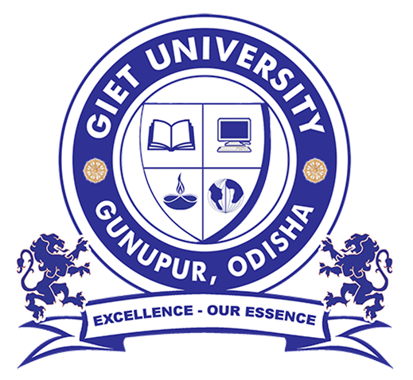
Organic Farming
SUB:-COMMUNICATIVE ENGLISH &
TECHNICAL COMMUNICATION
SUBMITTED BY:-
Om Prasad Pradhan
Jiban Jyoti Pradhan
Subrat Paramanik
SUBMITTED TO:-
Ms. Frtui Fiza
Asst. Professor
Dept. of BSH
GIET University, Gunupur

Slide 2
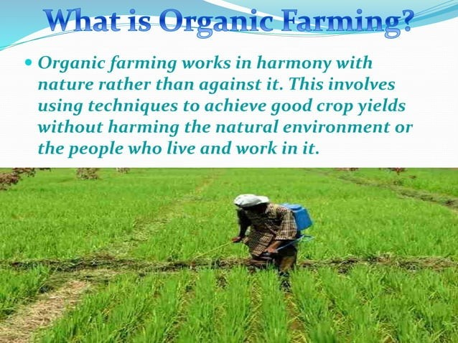
What is Organic Farming ?
Organic farming is also known as ecological farming or biological farming, it is an agricultural system that uses fertilizers of organic origin such as compost manure, green manure, and bone meal and places emphasis on techniques such as crop rotation and companion planting.
Organic farming certification in India is governed by The National Programme for Organic Production (NPOP) under the Ministry of Commerce & Industry.

Slide 3
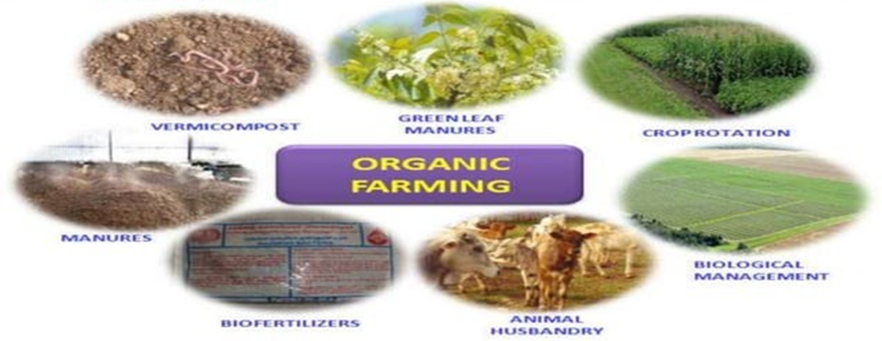
Components of Organic Farming
It involves the use of biological materials, avoiding synthetic substances and maintaining ecological balance thereby minimizing pollution and wastage.
It also includes processes like crop rotation, green manure, organic waste management, biological pest control, etc.

Slide 4
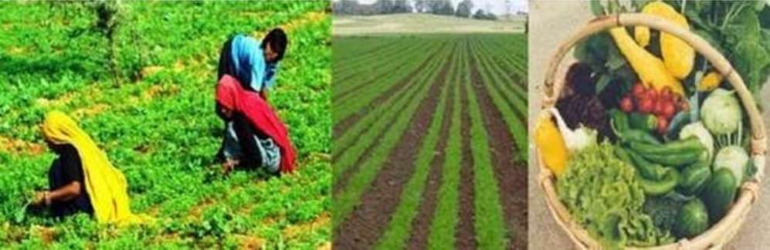
Aims Of Organic Farming
To maintain the long term fertility of the soil.
To reduce the input cost.
To effectively utilize the natural resources.
To avoid all forms of pollution caused by agricultural techniques.
To provide a quality foodstuff.

Slide 5
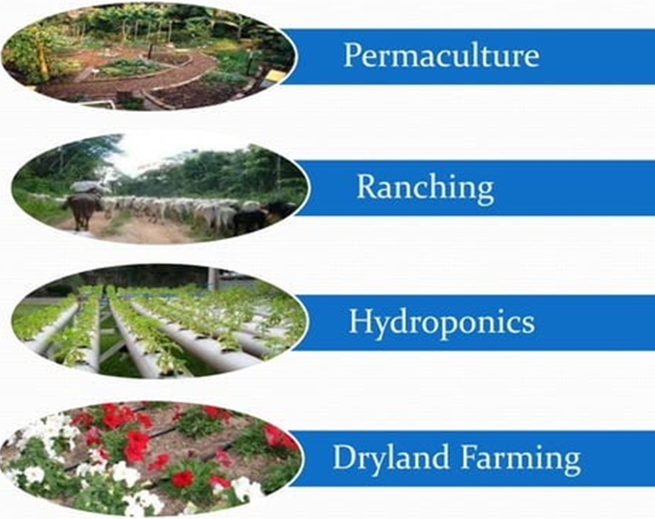
Types of Organic Farming

Slide 6
1.Permaculture:-
The development of agricultural ecosystems intended to be sustainable and self-sufficient.
2.Ranching:-
Ranching is the practice of raising herds of animals on large tracts of land.
3.Hydroponics:-
The process of growing plants in sand, gravel, or liquid, with added nutrients but without soil.
4.Dryland Farming:-
A method of farming in semi-arid areas without the aid of irrigation, using drought-resistant crops and conserving moisture.

Slide 7
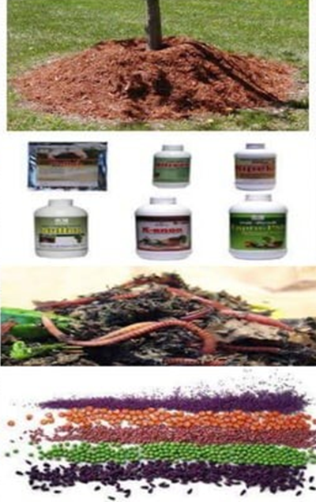
Techniques In Organic Farming
Mulching
Bio-Fertilizer
Vermi-compost
Seed treatments

Slide 8
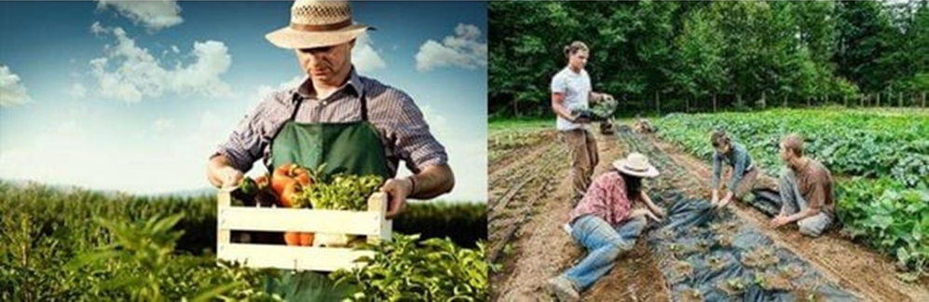
Uses And Benefits
• Reduction of Toxic Substances in the Environment.
• Job Creation.
• Assisting the Fight Against Climate Change.
• Preservation of the Culture of Agriculture Reduction of Farm waste.

Slide 9
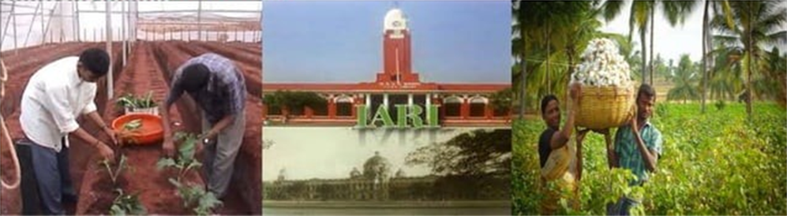
Scope In India
India's rich heritage of agricultural traditions makes it suitable for designing organic production systems.
With greater political will and investment in research, extension and marketing infrastructure more of this potential could be realized.
The agronomy division of Indian Agricultural Research Institute (IARI) has started many courses including package and practices for organic farming which can promote great career opportunities in organic farming.

Slide 10
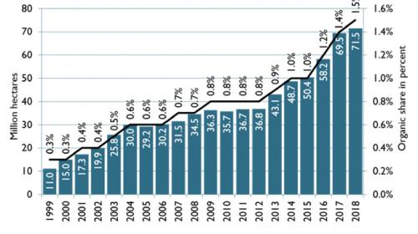
Growth Of Organic Farming In India
With the increasing demand for organic products in India, the certification and regulation of the organic sector came into being and thrived.
As a result of its growing importance, the organic farming sector in India has very much increased over the course of years.

Slide 11


